Slide 1
Node.JS
Introduction

Slide 2
Why node.js ?
“Node's goal is to provide an easy way to build scalable Network programs”
About Node.js……
• Created by Ryan Dahl in 2009
• Development && maintenance sponsored by Joyent
• Licence MIT
• Last release : 0.10.31
• Based on Google V8 Engine
• +99 000 packages

Slide 3
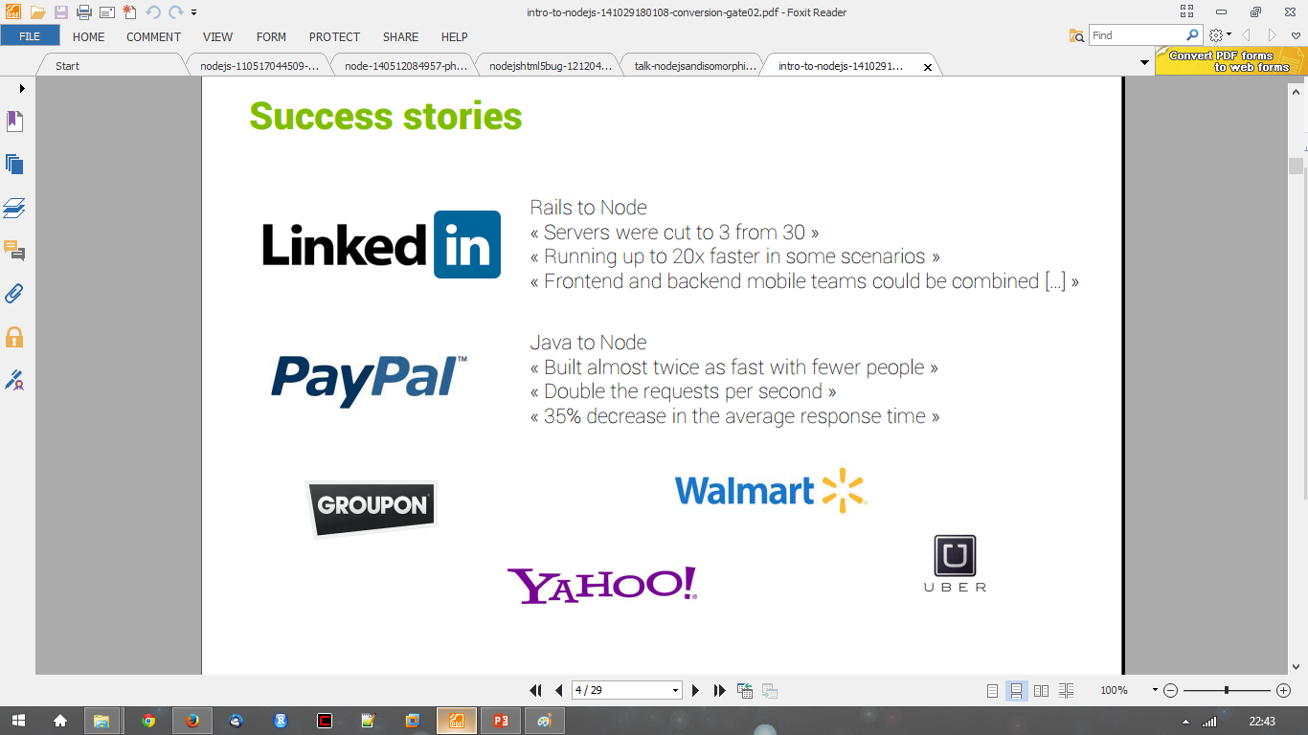
Using Node.js

Slide 4
HTTP Method……
● POST => Create
● GET => Read
● PUT => Update
● DELETE => Delete

Slide 5
Why node.js ?
● Non Blocking I/O
● V8 Javascript Engine
● Single Thread with Event Loop
● 40,025 modules
● Windows, Linux, Mac
● 1 Language for Frontend and Backend
● Active community

Slide 6
What is node.js?
Asynchronous i/o framework
Core in c++ on top of v8
Rest of it in javascript
Swiss army knife for network Related stuffs
Can handle thousands of Concurrent connections with Minimal overhead (cpu/memory) on a single process
It’s NOT a web framework, and it’s also NOT a language

Slide 7
Why JavaScript ?!!!
Friendly call-backs
Ubiquitous
No I/o Primitives
One language to RULE them all
JavaScript is well known for client-side scripts running inside the browser node.js is JavaScript running on the server-side
SSJS -> Server-Side JavaScript Use a language you know
Use the same language for client side and server side

Slide 8
The idea behind node.js….
Perform asynchronous processing on single thread instead of classical multithread processing, minimize overhead & latency, maximize scalability
Scale horizontally instead of vertically
Ideal for applications that serve a lot of requests but dont use/need lots of computational power per request
Not so ideal for heavy calculations, e.g. massive parallel computing
Also: Less problems with concurrency

Slide 9
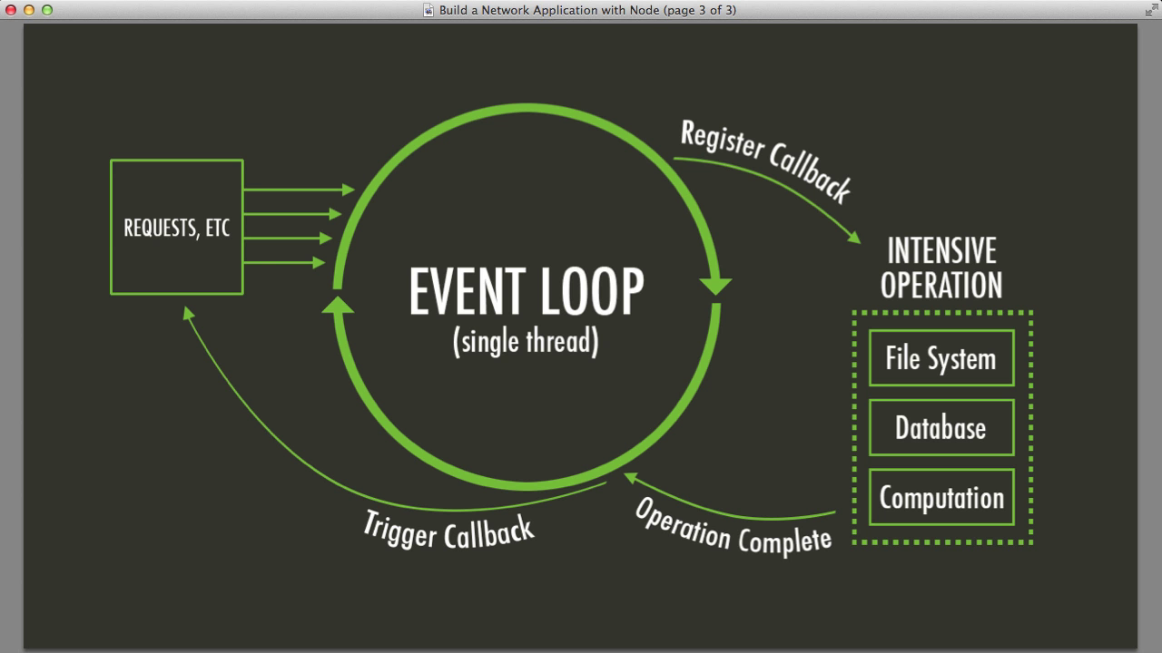
Node.js Event Loop
There are a couple of implications of this apparently very simple and basic model
Avoid synchronous code at all costs because it blocks the event loop
Which means: callbacks, callbacks, and more callbacks

Slide 10
Node.js for….
● Web application
● Websocket server
● Ad server
● Proxy server
● Streaming server
● Fast file upload client
● Any Real-time data apps
● Anything with high I/O

Slide 11
Node.js for…. (2)
Node.js allows you to run JavaScript on the server.
Node.js is an open source server environment.

Slide 12
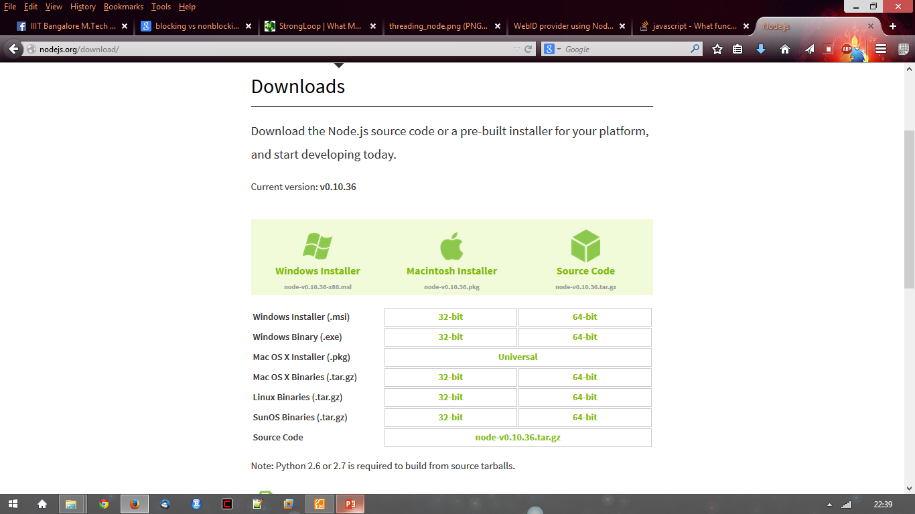
Getting Started…..
http://nodejs.org/ and download the correct version
Extract to any directory
$ ./configure && make install

Slide 13
hello-world.js

Slide 14
hello-world.js (2)
Save the file, go back to the terminal window, and enter the following command:
$ node hello-world.js
Output like this should appear in the terminal:
Server running at http://127.0.0.1:3000/
Now, open any preferred web browser and visit http://127.0.0.1:3000.
If the browser displays the string Hello, World!, that indicates the server is working.

Slide 15
File package.json…..
Project informations
• Name
• Version
• Dependencies
• Licence
• Main file
Etc...

Slide 16
Install module…..
$npm install <module name>
Using module…..
var http = require(‘http’);
var fs = require(‘fs’);
var express = require(‘express’);

Slide 17
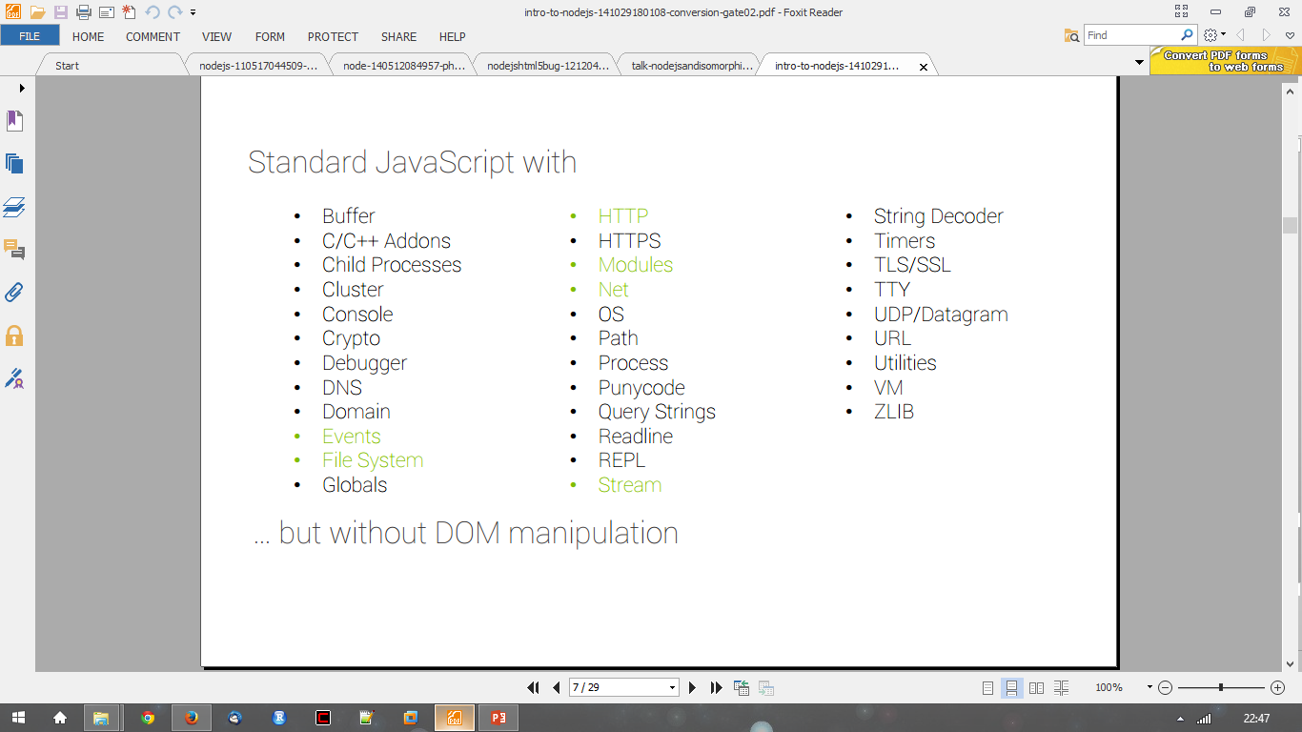
In NodeJS

Slide 18
Modules We will Use…..
● express
● request
● async
● mysql
Find more in npmjs.org…..

Slide 19
Express…
http://expressjs.com
Express. 4.17.1
Fast, unopinionated, minimalist web framework for Node.js

Slide 20
Express…(2)
Now install Express in the myapp directory and save it in the dependencies list. For example:
$ npm install express --save
To install Express temporarily and not add it to the dependencies list:
$ npm install express --no-save

Slide 21
Hello world example
const express = require('express')
const app = express()
const port = 3000
app.get('/', (req, res) => res.send('Hello World!'))
app.listen(port, () => console.log(`Example app listening at http://localhost:${port}`))
Run the app with the following command:
$ node app.js

Slide 22
Hello world example (2)
Respond with Hello World! on the homepage:
app.get('/', function (req, res) {
res.send('Hello World!’)
})

Slide 23
Hello world example (3)
Respond to POST request on the root route (/), the application’s home page:
app.post('/', function (req, res) {
res.send('Got a POST request’)
})

Slide 24
Hello world example (4)
Respond to a PUT request to the /user route:
app.put('/user', function (req, res) {
res.send('Got a PUT request at /user’)
})

Slide 25
Hello world example (5)
Respond to a DELETE request to the /user route:
app.delete('/user', function (req, res) {
res.send('Got a DELETE request at /user’)
})

